Slide 1
Presentation on “A Detailed Investigation and Analysis of using Machine Learning Techniques for Intrusion Detection”
By Md. Sayeduzzaman
Std no. 0405035

Slide 2
Authors :
Preeti Mishra, Member, IEEE,
Vijay Varadharajan, Senior Member, IEEE,
Uday Tupakula, Member, IEEE and
Emmanuel S. Pilli, Senior Member, IEEE,

Slide 3
Topics to be discussed
various category of attacks.
Limitations associated with each category
Data mining tools for machine learning
future directions are provided for attack detection using machine learning techniques.

Slide 4
Current security solutions
Middle-boxes
Firewall, Antivirus and Intrusion Detection Systems (IDS).
Firewalls limited
to the amount of state available and
knowledge of the hosts receiving the content.
IDS
monitors network traffic and scans the system and alerts the network administrator.

Slide 5
IDS types
IDS are mainly two types :
1. Host based Intrusion Detection System (HIDS)
Monitors and alerts individual host
2. Network based Intrusion Detection System (NIDS)
For network points i.e. gateway and routers
scans network traffic.

Slide 6
Detection mechanism
At high-level, the detection mechanism used by the IDSes are of three types :
1. Misuse detection
2. Anomaly detection
3. Hybrid detection

Slide 7
1. Misuse detection
detecting known attack types.
Knowledge based
Signature matching
Scans incoming packets against fixed patterns.
State transition analysis and
Rule based expert systems.

Slide 8
Anomaly detection
Attacker’s behavior vs normal user’s behavior.
Evolving attacks detection possible.
Three types :
Statistical techniques
Machine learning
Finite state machine (FSM)

Slide 9
Hybrid detection
Integrates misuse and anomaly detection approach

Slide 10
ML based approaches
Single classifiers with all features of data set
Single classifiers with limited features
Multiple classifiers with all features
Multiple classifiers with limited features

Slide 11
CLASSIFICATION OF ATTACKS :
Denial of Service Attacks(DOS)
Effect : Unavailability of services to users.
Types:
Resource Depletion
Bandwidth Depletion.
Overloads the network.
Flooding attacks
Amplification attacks

Slide 12
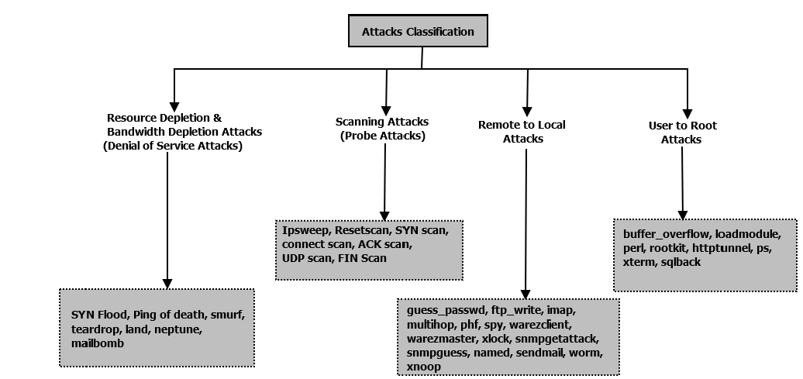
Various Attacks based on KDD’99 dataset :

Slide 13
Different types of attack
Land: sending packets with source address == destination address.
Effective in some TCP/IP implementations.
Attack feature: Feature ‘Land’ value is 1
Teardrop: Sends fragmented packets (overlapping).
Machine crashes due to improper handling of the overlapping packets.
Attack Feature: ‘Wrong Fragment’ (sum of bad checksum packets) provides clue.

Slide 14
Type of attack:
Smurf: Sends a large # of ICMP echo messages to a broadcast IP. Makes victim’s resources busy uselessly.
Feature: Large # of ICMP echo replies to victim without sending any ICMP
Ping of Death: Sending IP packet larger than the 65,536 bytes.
Feature : Size of ICMP packets

Slide 15
Type of attack:
Mailbomb: sending a large # of emails with large attachments to a particular mail server
filling up disk space
denied email services to other users.
Feature: thousands of mails coming from same user within a short period of time.

Slide 16
Type of attack:
SYN Flood: sends the SYN request , but never reply to ACK
pending connection queue fills up evetually
system unable to accept new incoming connections.
Feature:
# of simultaneous SYN packets from unreachable host
threshold on waiting time for the reply.

Slide 17
B. Scanning Attacks :
SYN scan:
Attacker does not make a complete TCP connection.
Opens ports respond with SYN-ACK, and close port responds with RST.
Feature: large half-open connections with Flag either REJ or S1

Slide 18
C. User to Root(U2R) Attacks
Gains the root access to a machine
Buffer overflow attack:
Exploits the vulnerability of a user program.
copies too much data in a static buffer
overflows the buffer and causes arbitrary commands to be executed by OS.

Slide 19
C. User to Root(U2R) Attacks
Ffbconfig attack: Attacker overwrites the internal stack space of the ffbconfigct program which does not perform sufficient bound checking on arguments.
Loadmodule attack : Attacker exploits the bug present in the loadmodule program to gain root access to the machine.

Slide 20
C. User to Root(U2R) Attacks
Rootkit attacks:
Backdoor installation using Rootkits to bypass the root privileges .
Rootkits hide many suspicious processes

Slide 21
D. Remote to User(R2U) Attacks
Gaining local access to the vulnerable machine
Dictionary/Guess Password attack :
Guesses possible username and password.
FTPwrite attack : Adds files to non write protected ftp directory and gains access to the machine.

Slide 22
D. Remote to User(R2U) Attacks
Imap attack: Exploits the buffer overflows of the Imap server
Xlock attack : Exploits the unprotected X console of the user to gain access to the machine.
User trapped to enter password in attacker’s given display

Slide 23
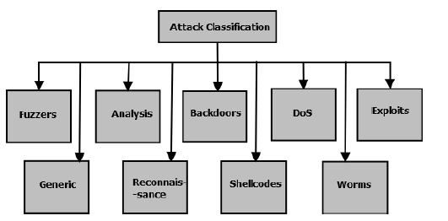
Various Attacks based on UNSW-NB dataset

Slide 24
E. Fuzzers
Sends a large randomly generated input as protocol packets.
Discovers security loopholes in the OS
Indication:
large number of packets
same service protocol
same destination port number over some duration of time.

Slide 25
F. Analysis
penetrates the web applications
port scanning, malicious web scripting (like HTML files penetration) and sending spam emails etc.

Slide 26
G. Backdoor
unauthorized remote access to a system.
backdoor programs to install the malicious files
Important features : fsport, dsport, dur, sbytes, service, ackdat, sjit, djit.

Slide 27
H. Exploits
Exploits the software vulnerabilities
Attackers utilize the knowledge of the software to launch exploits
Monitoring the os behavior using dynamic analysis techniques.

Slide 28
I. Generic
Breaks the (criptographic) key of the security system.

Slide 29
J. Reconnaissance
To gather information about the target computer network
a preliminary step towards launching further attacks.
Attacker use port scanning, OS scanning, nslookup, dig, whois, etc.
sufficient information can be used to launch DDoS, worm, bufferoverflow exploits etc
Network features to detect such attacks:
fsport, dsport, srcip, dstip, dur, spkts, sinpkt, service, synack, ct srv src, ct src ltm, ct dst ltm g.

Slide 30
K. Shellcode
Exploit the software’s vulnerability.
starts a command shell
bindshell connects the attacker to a certain port of victim machine.
low-frequency attack

Slide 31
L. Worms
Worms are malicious programs or malware
spread to other computers.
do not try to change the system files.
increases network traffic.

Slide 32
Techniques used in Machine Learning

Slide 33
1) Decision Tree:
Illustrates every possible outcome of a decision.
Each branch represents one of the possible values for attribute.
Leaf node represents the class to which the object belongs.
decision tree algorithms : ID3, C 4.5 , CART , LMT Tree, etc.

Slide 34
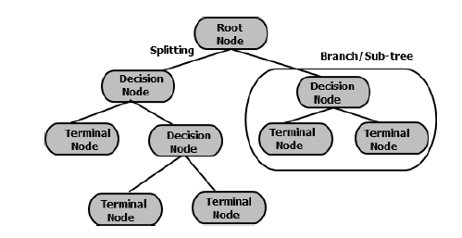
Graphical representation of Decision Tree

Slide 35
Decision Tree
A decision tree is suitable for the problems where
(a) Instances can be represented by attribute-value pairs. Each attribute can have a disjoint set of possible values.
(b) Target function should have discrete output value (for ex. yes or no).
(c) The training data may have errors. Decision trees are robust to errors.
(d) Training data may contain missing attribute values

Slide 36
2) Artificial Neural Network(ANN):
robust approach for approximating realvalued, discrete-valued and vector-valued target functions.
classification algorithms using Neural Network.
Back Propagation Algorithm,
Adaptive Resonance Theory based,
Radial Basis Functions based,
Neural Tree
Three main elements:
input node, hidden nodes ,output node

Slide 37
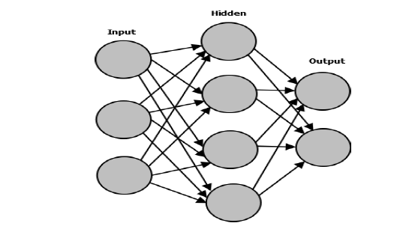
Input, Hidden and Output layers in Neural Network

Slide 38
Artificial Neural Network(ANN):
Suitable for where:
Multi attributed-value pairs.
output may be discrete-valued, real-valued or vector of real or discrete values.
Training sample may contain errors. ANN is robust to noise.
requires larger dataset
performance depends on the trained parameters and dataset

Slide 39
3) Naive Bayes Classifier:
Assumption
attribute values are conditionally independent
It is applied to the learning task where
instance x is described by a conjunction of attributes
target function f(x) can take any value from a set of target values

Slide 40
Naive Bayes Classifier:
Suitable where :
discrete output value (yes or no).
Attribute-value pairs can represent instances.
The independent assumption is acceptable
assumption
features are independent
Hidden Naive Bayes is an extension of Naive Bayes
relaxes this assumption.
99.6% accuracy for DoS .

Slide 41
4) Support Vector Machine:
SVM is based on the notion of the margin-either side of the hyperplane that separates two data classes as shown in Figure.
The generalization error can be reduced by
maximizing the margin
creating the largest possible distance between the separating hyperplane and instances on either side of it

Slide 42
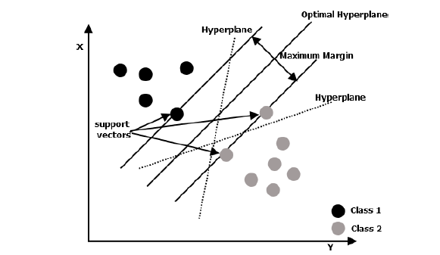
Multi-class Linear SVM

Slide 43
SVM
SVM based on the type of kernel function:
Linear SVM
Non-linear SVM
Based on the type of detection (misuse/anomaly)
Multi-class SVM
one-class SVM.

Slide 44
SVM
Drawback
extensive memory requirement
algorithmic complexity.

Slide 45
5) Genetic Algorithms:
search algorithms that find an approximate solution.
Three operators: selection, crossover, and mutation are sequentially applied to each with certain probabilities.

Slide 46
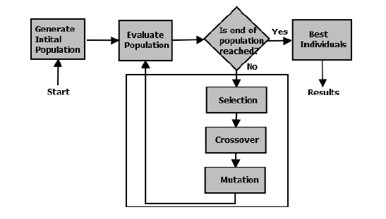
Execution Flow of Genetic Algorithm

Slide 47
GA
Characteristics:
a) intrinsically parallel, they can explore solution space in multiple directions at once.
b) well suited for the problems where the space for the potential solutions is truly large.
c) No gradient information is required.
d) Do not require complex mathematics to execute.
e) They work with a population of solutions rather than a single solution

Slide 48
6) K-means Clustering:
Clustering based anomaly detection algorithms.
Assumption
normal data instances lie close to their closest cluster centroid while anomalies lie far away from their closest cluster centroid .
fails if the anomalies in the data form the clusters by themselves.

Slide 49
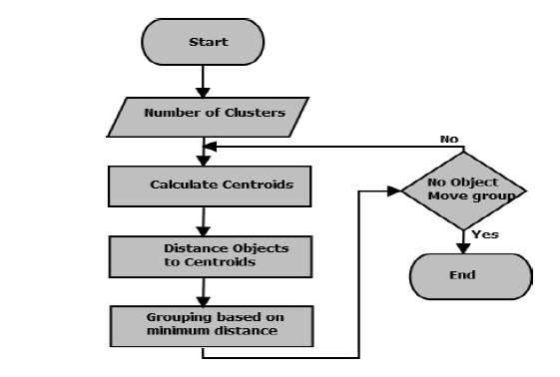
Execution Flow of K-means Clustering

Slide 50
7) K-Nearest Neighbor Approach:
K-NN is an instance based learning algorithms.
no assumptions on the underlying data distribution.

Slide 51
K-Nearest Neighbor Approach:
characteristics
a) no assumption on data.
b) sensitive to the choice of similarity function
c) require large storage.
d) Computationally expensive technique.
e) not robust to noise and can misclassify instances if noise is present.

Slide 52
8) Fuzzy Logic:
Offers rigor of formal methods without requiring undue precision.
Fuzzy logic is not enough to detect all types of attacks.
performs well when it is integrated with other classifiers.

Slide 53
Fuzzy Logic:
Characteristics
(a) allow constructing the if-then rules
(b) They can combine the input from varying sources.
(c) The quantitative measures used by IDS such as connection interval, CPU usage time, etc. are fuzzy in nature.
(d) The degree of alert that can be produced by an IDS is often fuzzy

Slide 54
9) Hidden Markov Model:
a behavioral model
composed of states, transitions and actions.
under the category of Markov Models.

Slide 55
10)Swarm Intelligence:
Swarm Optimization is an advanced machine learning algorithm which is based on the evolutionary computations.

Slide 56
publicly available datasets
KDD’99, DARPA 1998.
Recent attack datasets
ISCX 2012
UNSW-NB15
ML techniques Categories
. (i) Single classifiers with all features.
(ii) Single classifiers with limited features.
(iii) Multiple classifiers with all features
(iv) Multiple classifiers with limited features.

Slide 57
Previous researches on datasets
1. Network Intrusion Detection:
Technique : Support Vector Machine (SVM)
Dataset: KDD’99 .
Detection rate:
91.6% for DoS,
36.65% for Probe attack
12% for U2R attack
22% for R2L attacks.

Slide 58
Previous researches on datasets
2. Intrusion Detection :
Approaches : Naive Bayes and Decision tree
Dataset: KDD’99
Performance:
very poor for low-frequency attacks (U2R and R2L).
NB
96.65% for DoS
88.33% for probe
DT
97.24% for DoS
77.92% for probe attack.

Slide 59
Previous researches on datasets
3. Intrusion Detection
Approach :
Back Propagation Neural Network (BPL NN) classifier
Decision tree
Dataset : KDD’99
Detection Rate:
99.99% for DoS,
99.78% for probe,
90.39% for U2R
98.93% for R2L

Slide 60
Previous researches on datasets
4.Misuse detection
Technique : fuzzy association rules
Dataset : KDD’99.
Detection rate:
78.9% for DoS
88.5% for probe attack,
U2R for 68.6%
R2L for 6.2%
Overall 70%-90% with 2% false positives.

Slide 61
Previous researches on datasets
5. Detecting attacks in the cyber network.
Technique : ML
Accuracy :
DT : 88.67%,
NB : 73.8%
SVM with RBF kernel : 70.15%
SVM with polynomial kernel : 68.06%

Slide 62
Previous researches on datasets
8. Detecting application-layer DDoS attack:
Uses : Non-parametric CUSUM algorithm.
Performance:
selective sampling : 100% , 0% false positive
9. Intrusion detection framework
Uses : support vector machine (SVM)
Detection rate : 99.20%
False alarm rate : 0.60%.

Slide 63
Previous researches on datasets
Hidden Naive Bayes Classifier
Dataset : KDD’99 .
DoS detection rate : 99.60%
Overall detection 93.72%

Slide 64
Previous researches on datasets
Misuse detection.
Algorithm : multi-objective genetic algorithm (MOGA)
Dataset : ISCX 2012
Detection rate : 97.0%
FPR: 2.4%

Slide 65
Previous researches on datasets
Deep packet inspection technique
Detection rate :
96.7% for encrypted traffic
96.6% for unencrypted traffic w
Dataset : ISCX .

Slide 66
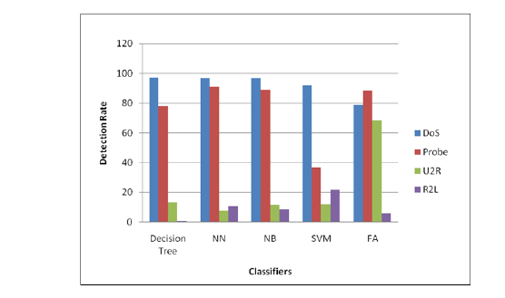
PERFORMANCE ANALYSIS OF DIFFERENT MACHINE LEARNING ALGORITHMS IN INTRUSIONS DETECTION
Performance comparison of single classifiers with 41 features for different Attacks :

Slide 67
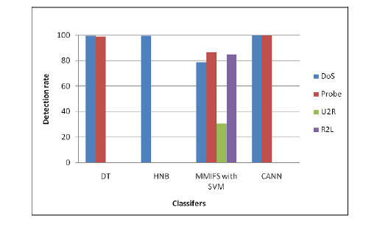
Performance comparison of single classifiers with feature selection

Slide 68
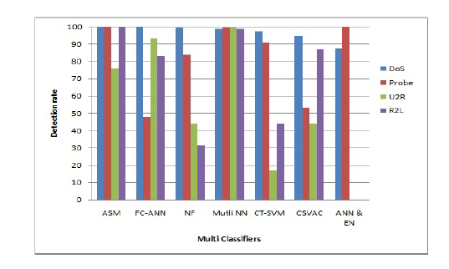
Performance comparison of multiple classifiers with all features

Slide 69
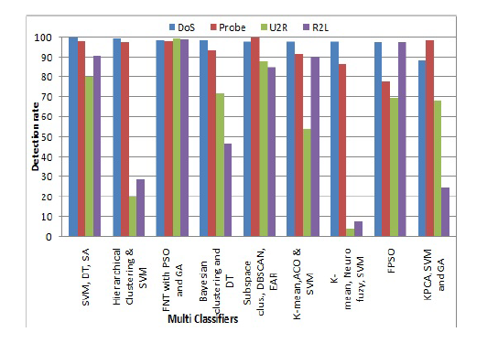
Performance comparison of multiple classifiers with feature selection

Slide 70
DATA MINING TOOLS FOR MACHINE LEARNING
A. Weka
B. Scikit-learn
C. TensorFlow
D. KMINE
E. RapidMiner
F. Environment for Developing KDD-Applications Supported by Index-Structure (ELKI)
G. Massive Online Analysis (MOA)

Slide 71
CONCLUSION
The difficulties associated with detecting the low-frequency attacks using machine learning techniques over network dataset have been described. It motivates researchers to work on other solutions to detect the Low-frequency attacks. Future research directions are provided to help researchers exploring more efficient solutions for attack detection.

